Slide 1
Business Organization
Business Information Systems – 420-E01
Reference: Rainer, Introduction to Information Systems, 2nd Can. Ed.
Notes:
Pfeiffer book, Chapter 3-5

Slide 2
Managing Information Resources
Which IT resources are managed and by whom?
During the early 1950s, Information Systems Department (ISD) managed ALL of the only computing resource, the mainframe.
Today, computing resources are located through the organization and almost all employees use computers in their work. This system is known as end user computing.

Slide 3
Managing Information Resources
The role of the IS department
The ISD is responsible for corporate-level and shared resources and for using IT to solve end users’ business problems.
End users are responsible for their own computing resources and departmental resources.
ISD and end users work together as partners to manage the IT resources.

Slide 4
The Role of the IS Department
Traditional Major IS Functions
Managing systems development and systems project management
Managing computer operations
Staffing, training, developing IS skills
Providing technical services
Infrastructure planning, development, control

Slide 5
The Role of the IS Department
New (Consultative) IS Functions
Initiating and designing strategic information systems
Incorporating the Internet and e-commerce into the business
Managing system integration
Educating non-IS managers about IT
Educating IS staff about the business
Supporting end-user computing
Managing outsourcing
Innovate
Ally with vendors and IS departments in other organizations

Slide 6
Roles in a Private Organization
CEO – Chief Executive Officer
Head of the organization
CFO – Chief Financial Officer
Responsible for overseeing all financial aspects of organization
COO – Chief Operational Officer
Responsible for managing day to day operations
CPO – Chief Privacy Officer
Responsible for ensuring the ethical and legal use of information within organization
Notes:
Active learning exercise to get students to figure out all of the acronyms and what they do.

Slide 7
Roles in a Private Organization
CIO – Chief Information Officer
Oversees all users of information systems; ensures strategic alignment of IS with business goals
CTO – Chief Technology Officer
Ensures availability and reliability of all IT
Usually report to CIO
Sometimes the CIO and CTO titles are used interchangably

Slide 8
Review Pitney-Bowes Case Study
What is the role of Pitney Bowe’s IT department?
Is the IT department of strategic importance to the company?
What is the relationship between Pitney Bowes’s IT department and Wipro?
Is Wipro of strategic importance to Pitney Bowes?
What is the role of Pitney Bowes’s IT department with regard to Wipro?
Notes:
Describe the role of Pitney Bowes’s IT department. Is the IT department of strategic importance to the company? Support your answer.
Pitney Bowes supports one global IT department, under the responsibility of the company’s CIO. It focuses on both internal and external customers.
Internally, IT is used to provide reliable and efficient services, and to better solve their business problems.
Externally, IT ‘s role is to offer more value to customers in end-to-end solutions for the critical mail and document processes that drive business.
The IT department concentrates on applications such as enterprise resource planning, customer relationship management, mobile capabilities, and greater use of the Web.
The IT department is of strategic importance because they must integrate with major national mail systems and compete with document management companies and other service providers of document messaging/imaging technologies.
Consequently, Pitney Bowes builds a business case to show that a new system will support a current or an emerging business need. So, for a new project to be approved, it must either cut costs or improve service without costing more.
2. What is the relationship between Pitney Bowes’s IT department and Wipro? Is Wipro of strategic importance to Pitney Bowes? What is the role of Pitney Bowes’s IT department with regard to Wipro?
Wipro Technologies is a services partner with whom Pitney Bowes outsources extensively. Wipro handles most of their software application development and maintenance.
The partnership with Wipro has saved PB money, given the company access to a larger pool of labour and skills, and provided products of higher quality. Therefore, Wipro is of strategic importance.
The IT department has 200 employees, plus an additional 427 people who work on Pitney Bowes projects through Wipro Technologies

Slide 9
Roles in the Federal Government
Minister
Deputy Minister (DM)
Assistant Deputy Minister (ADM)
Director General (DG)
Regional Director General (RDG)

Slide 10
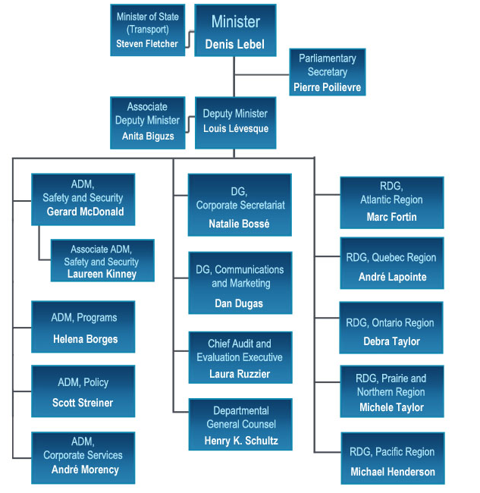
Notes:
Transport Canada Org Chart

Slide 11
Federal Government CS Levels
If you work for the Federal Government when you graduate, you would be hired as a “CS1”
What does CS stand for?
How many CS levels are there?
What is the salary range for a CS1?
Notes:
Have the students figure out the CS levels of government and their salaries.

